Slide 1
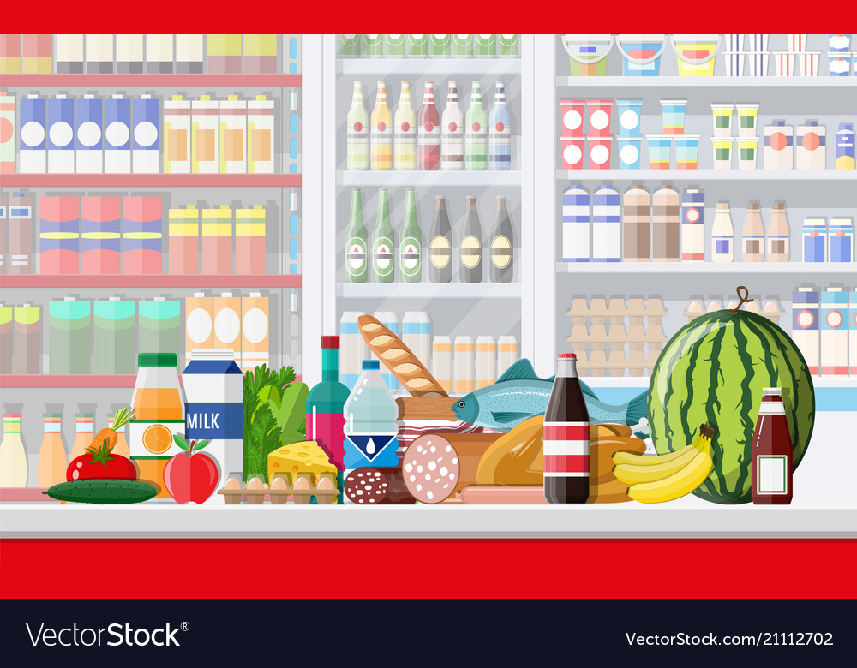
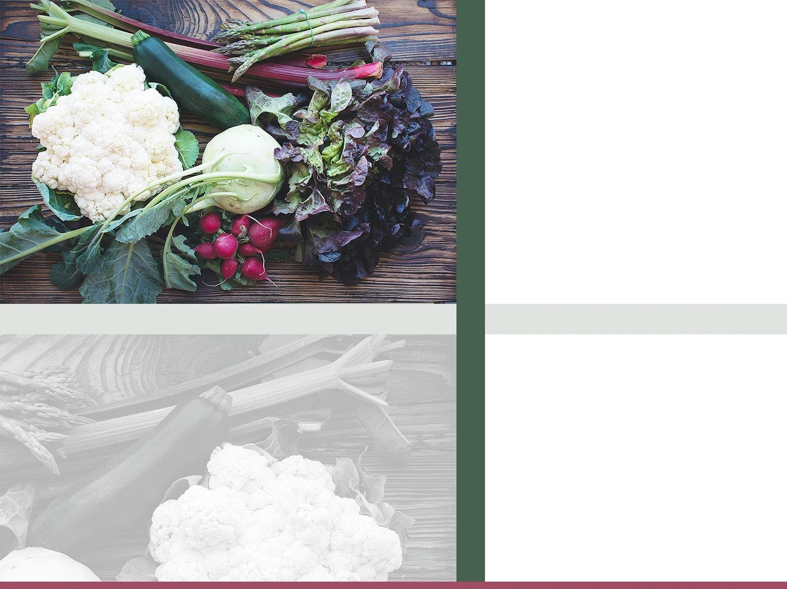
INSTACART MARKET BASKET
ANALYSIS
By – Rajadurai DJ

Slide 2
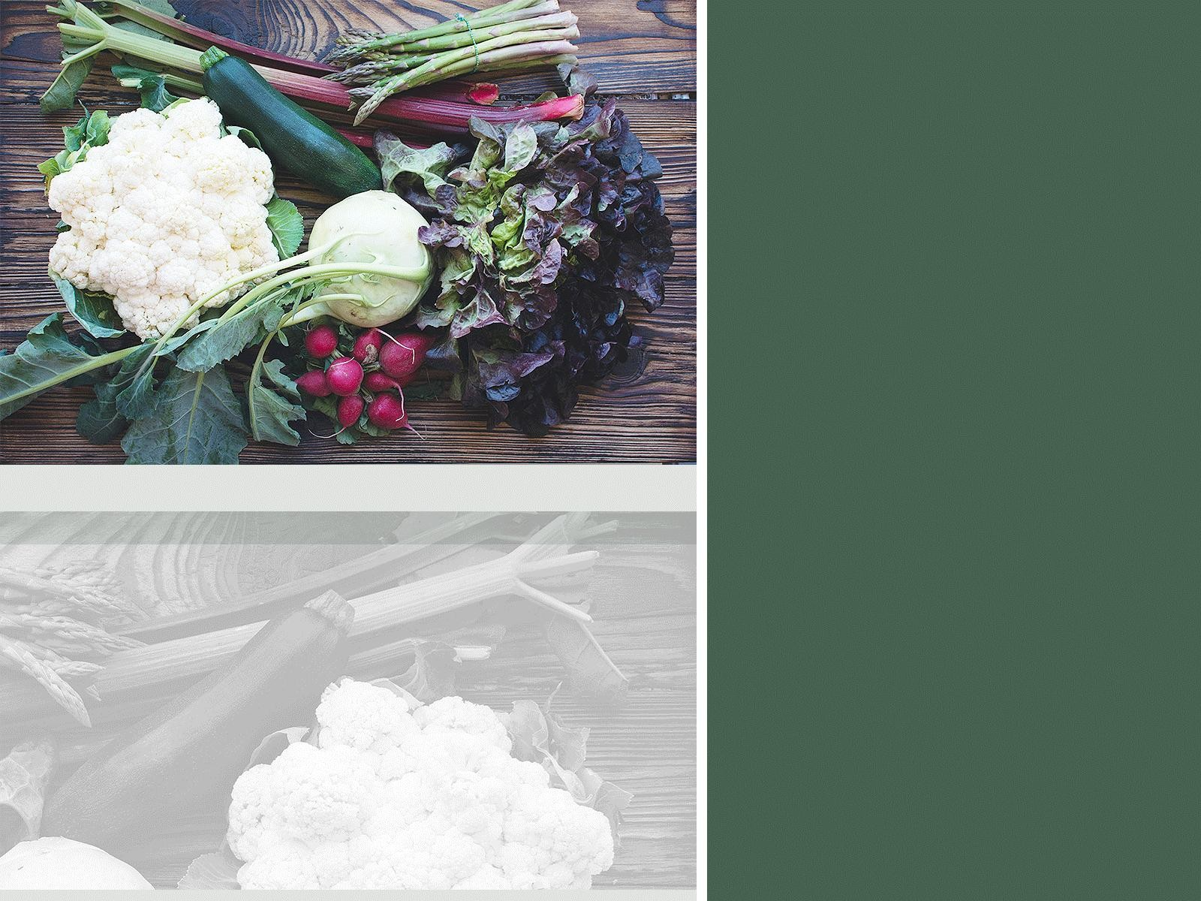




Table of Contents
Customer Behavior
Analyze ordering patterns to identify
customer preferences and frequency of reorders.
Product Analysis
Determine which products are most popular,
frequently reordered, and identify trends in product sales across different departments and aisles.
Order Analysis
Determine which products are most popular,
frequently reordered, and identify trends in product sales across different departments and aisles.
Suggestions

Slide 3
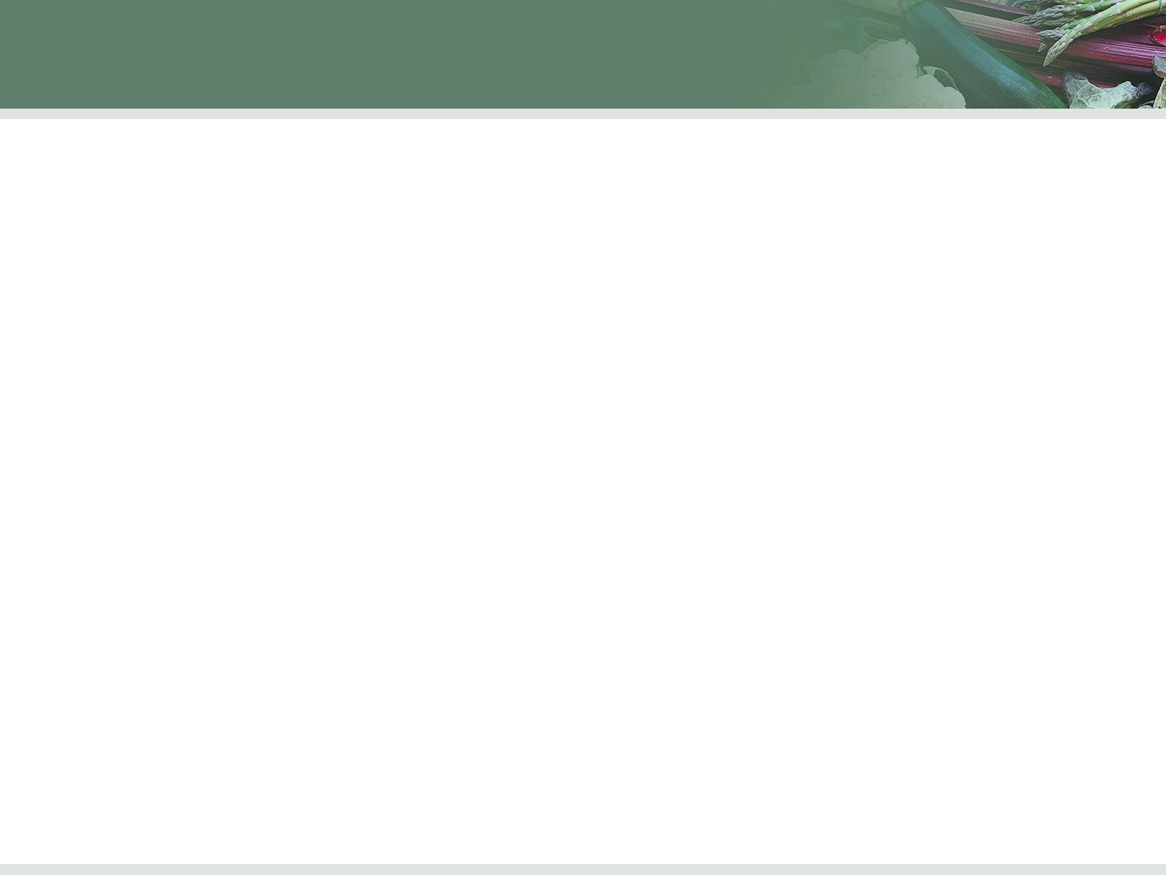
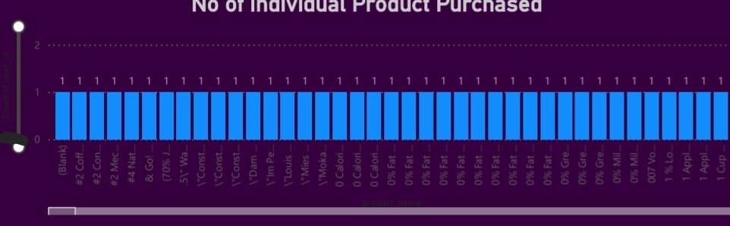
Customer Behavior
More reorders are happened in (Produce, Canned Goods, Pantry, Personal Care, Frozen, beverages) departments
Nearly 13% of customers made purchase in beverage department & 11% of customers has made a purchase in pantry & dairy eggs
Snacks & Beverages are very close near this might been attract customers to made pitch both.

Slide 4
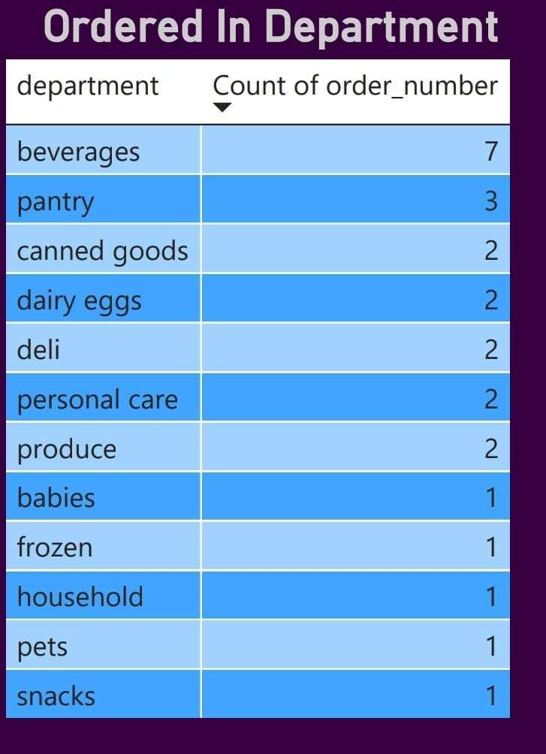
Product Analysis
The Beverages, Snacks & Dairy eggs hits more numbers by Add to cart.
Products from Beverages, pantry, frozen, snacks, personal care, produce, pantry, dairy eggs departments Has order more.
This products are arranged in near to near aisels (3,4, & 7).

Slide 5
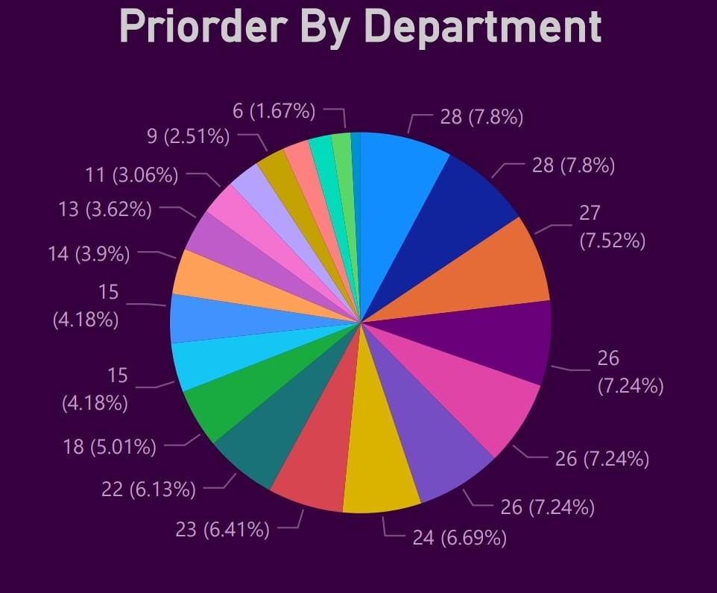
Order Analysis
The Beverages, Snacks & Dairy eggs hits more numbers by Add to cart.
And again snacks, dairy eggs & beverages hits more pri-ordered
This products are arranged in near to near aisels (3,4, & 7).

Slide 6
Suggestions
Like offer given as apple + another product in different department has shown that more product is purchased in both the departments
The same buy one get one offer should give to all the departments with standard rates.
And the same with milk bread can be offered with some price to hits more sales.
More sale is happening after 2pm
Daily Consumables can be offered in morning time specifically to increase sales more.

Slide 7
THANK YOU

